Slide 1

Chapter 14
Wireless LANs

Slide 2
14-1 IEEE 802.11
IEEE has defined the specifications for a wireless LAN, called IEEE 802.11, which covers the physical and data link layers.
Topics discussed in this section:
Architecture
MAC Sublayer
Physical Layer

Slide 3
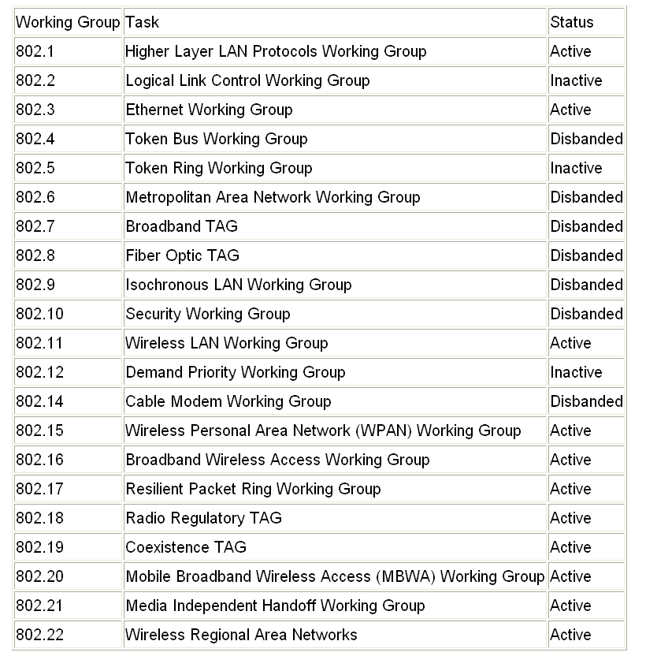
IEEE 802 Standards Working Groups
IEEE 802 Standards Working Groups
IEEE 802.16e :
(Mobile) Broadband Wireless Access
WiMAX, an acronym that stands for Worldwide Interoperability for Microwave Access(802.16)
WiFi (Wireless Fidelity) : 802.11
TAG (Technical Advisory Group)

Slide 4
15.1 IEEE 802.11 - Architecture
Basic Service Set (BSS)
Extended Service Set (ESS)

Slide 5
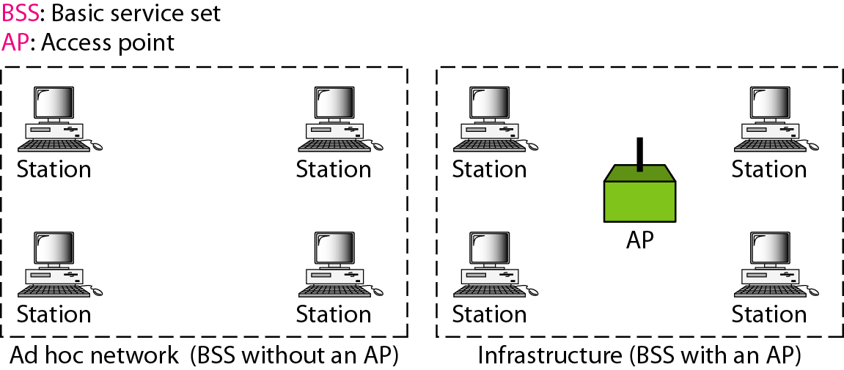
Basic Service Set
made up of stationary or mobile wireless stations, and possibly a central base station (access point)
BSS without an AP is stand-alone, cannot send data to other BSSs

Slide 6

Basic Service Set
Note
A BSS without an AP is called an ad hoc network;
a BSS with an AP is called an infrastructure network.

Slide 7
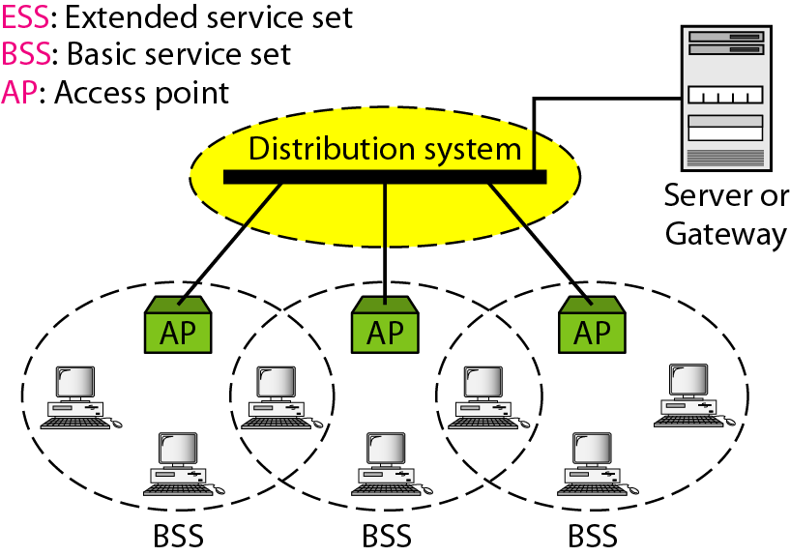
ESS – Extended Service Set
Made up of two or more BSSs with APs – connected through a distribution system (usually a wired LAN)

Slide 8
Station Types
No-transition mobility – either stationary or moving only inside a BSS
BSS-transition mobility – can move from one BSS to another, confined to one ESS
ESS-transition mobility – can move from one ESS to another

Slide 9
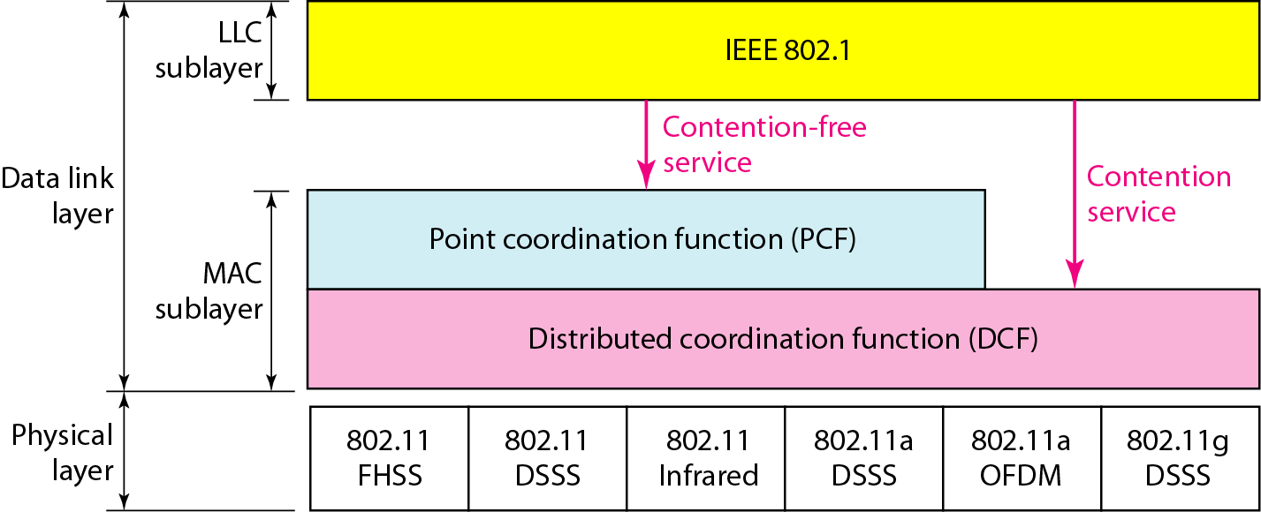
MAC Sublayer
Figure 14.3 MAC layers in IEEE 802.11 standard
802.11 defines the specs for the conversion of bits to a signal

Slide 10
Distribution Coordination Function
One of the two protocols defined by IEEE at the MAC sublayer is called the Distributed Coordination Function (DCF)
  DCF uses CSMA/CA as the access method.
  Wireless LANs cannot implement CSMA/CD for three reasons:
1. For collision detection a station must be able to send data and receive collision signals at the same time. This can mean costly stations and increased bandwidth requirements.
2. Collision may not be detected because of the hidden station problem.
3. The distance between stations can be great. Signal fading could prevent a station at one end from hearing a collision at the other end.

Slide 11

CSMA/CA Process flowchart
Figure 14.4 CSMA/CA flowchart

Slide 12
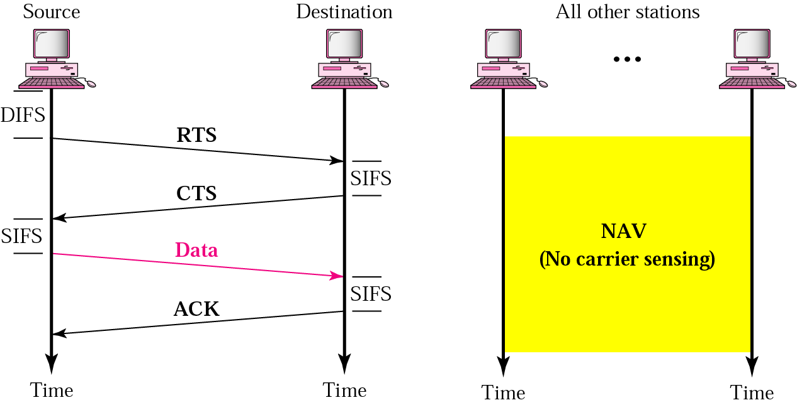
Frame Exchange Time Line
Figure 14.5 CSMA/CA and NAV
DIFS – distributed interframe space, NAV – network allocation vector
SIFS – short interframe space, RTS – request to send, CTS – clear to send
* Collision only occurs during handshake period (RTS, CTS)

Slide 13
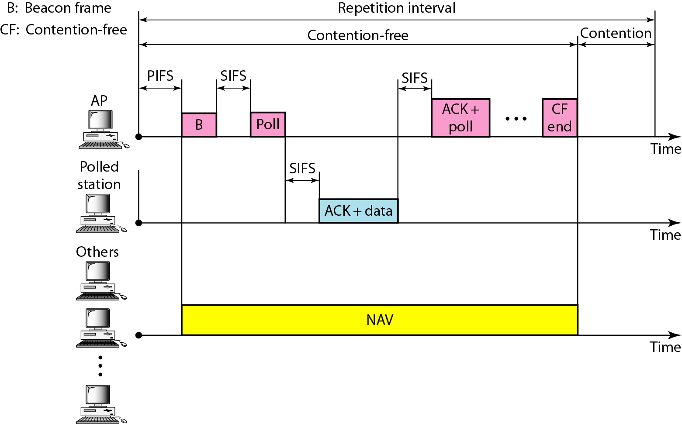
PCF
Point Coordination Function (PCF)
  PCF is an optional access method that can be implemented in an infrastructure network.
  It is implemented on top of the DCF and is used mostly for time-sensitive transmission.
Figure 14.6 Example of repetition interval

Slide 14

Frame format
FC : frame control
D: the duration of the transmission that is used to set the value of NAV
SC: Sequence Control – defining the sequence number of the frame to be used in flow
flow control

Slide 15
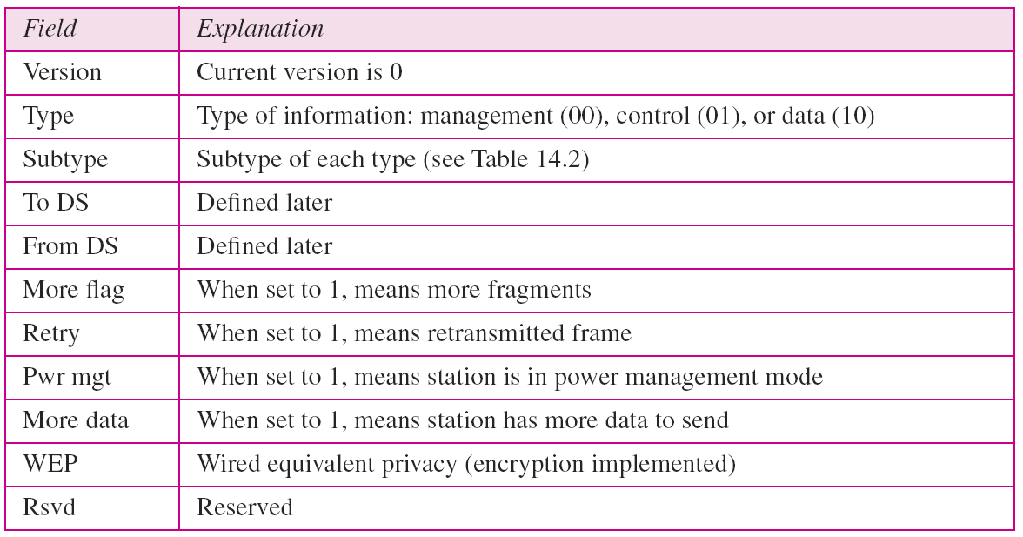
Frame format
Table 14.1 Subfields in FC field

Slide 16
Management Frames
A wireless LAN in IEEE 802.11 has 3 categories
  Management Frame : 00
    Used for the initial communication between stations and access points.
  Control Frame : 01
    Used for accessing the channel and acknowledging frames.
  Data Frame : 10
    Used for carrying data and control information.

Slide 17
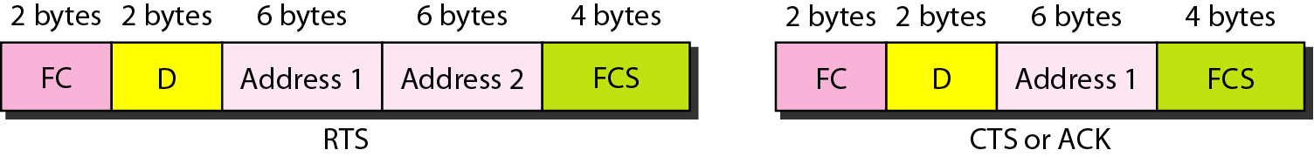

Control frames

Slide 18
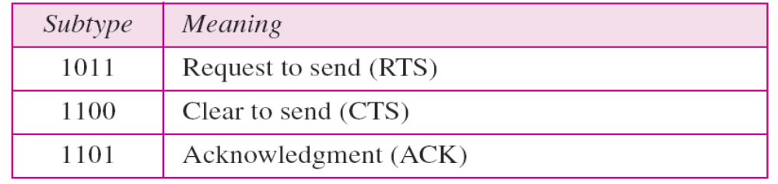
Subtype values of subfields in control frames
Table 14.2 Values of subfields in control frames
type field : 01

Slide 19
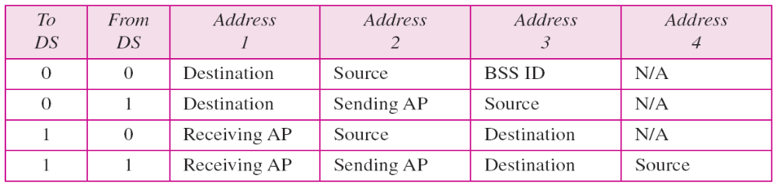
Addressing Mechanism
Table 14.3 Addresses

Slide 20
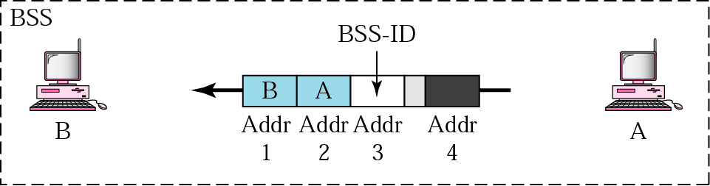
Addressing mechanism: case 1
To DS = 0 and From DS = 0
Frame is not going to a distribution system
Frame is going from one station in a BSS to another
ACK sent to original sender

Slide 21
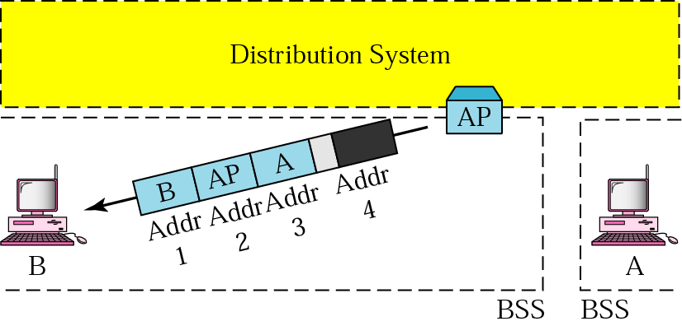
Addressing mechanism: case 2
To DS = 0 and From DS = 1
Frame is coming from a distribution system
Frame is coming from an AP and going to a station
ACK sent to AP

Slide 22
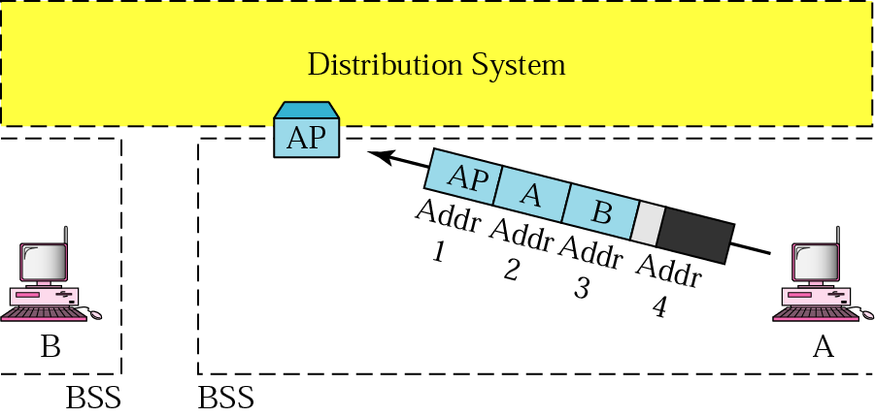
Addressing mechanism: case 3
To DS = 1 and From DS = 0
Frame is going to a distribution system
Frame is coming from a station to an AP
ACK sent to original station
address 3 contains final destination of frame

Slide 23
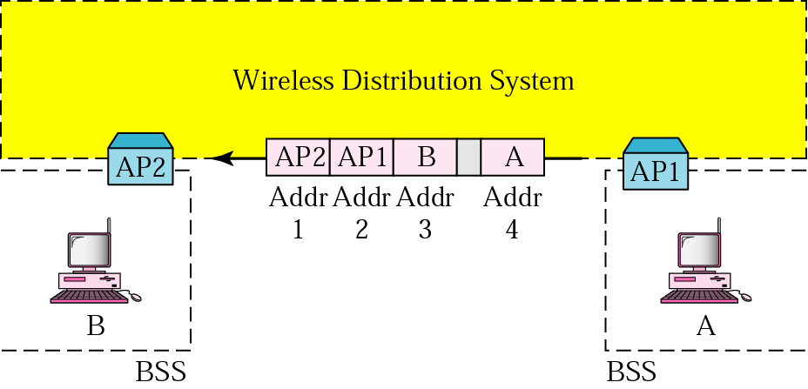
Addressing mechanism: case 4
To DS = 1 and From DS = 1
Distribution system is wireless
Frame is coming from an AP going to another AP
ACK sent to original station

Slide 24
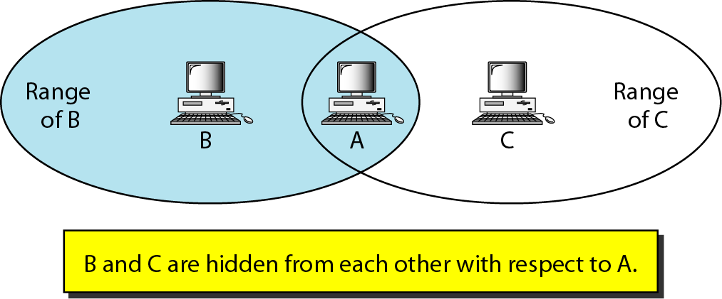
Hidden and Exposed Station Problems
Figure 14.10 Hidden station problem

Slide 25
Hidden and Exposed Station Problems
Note
The CTS frame in CSMA/CA handshake can prevent collision from
a hidden station.

Slide 26
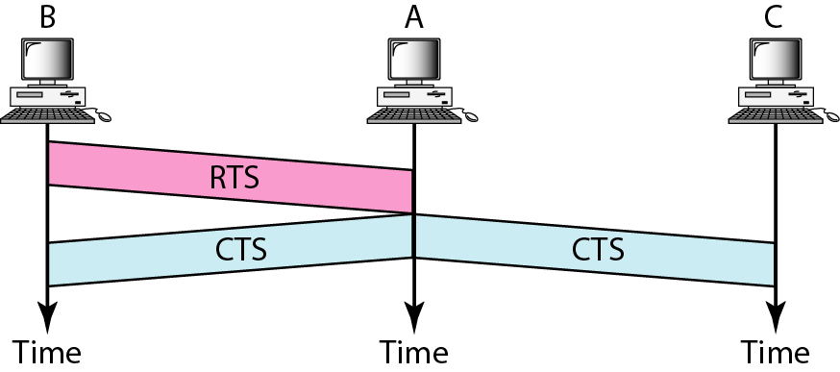
Hidden and Exposed Station Problems
Figure 14.11 Use of handshaking to prevent hidden station problem

Slide 27
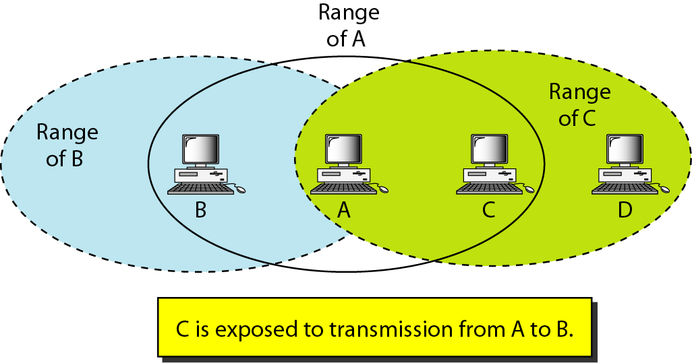
Hidden and Exposed Station Problems
Figure 14.12 Exposed station problem

Slide 28
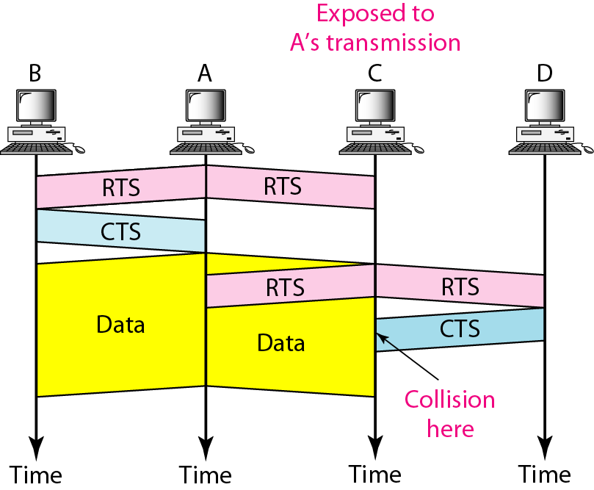
Hidden and Exposed Station Problems
Figure 14.13 Use of handshaking in exposed station problem

Slide 29
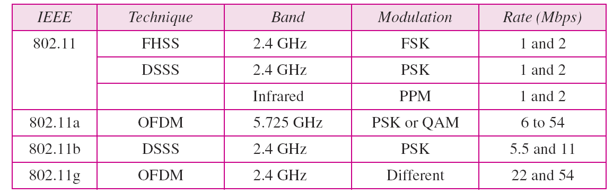
Physical Layer
Table 14.4 Physical layers

Slide 30
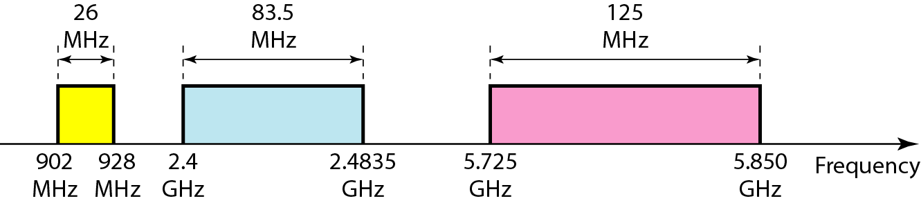
Physical Layer
Figure 14.14 Industrial, scientific, and medical (ISM) band

Slide 31
Summary
The IEEE 802.11 standard for wireless LANs defined two services: basic service set (BSS) and extended service set (ESS).
The access method used in the distributed coordination function (DCF) MAC sublayer is CSMA/CA.
The access method used in the point coordination function (PCF) MAC sublayer is polling.
The network allocation vector (NAV) is a timer used for collision avoidance
The Mac layer frame has nine fields. The addressing mechanism can include up to four addresses.
Wireless LANs use management frames, control frames, and data frames.
IEEE 802.11 defines several physical layers, with different data rates and modulating techniques.

Slide 32

Questions !

